Slide 1

Modernizing Security Data Management
From Bespoke Complexity to Standardized Automation with AWS Security Lake
Zero
OCSF
AI-Ready
Parsers Required
Open Standard Format
Native GenAI Integration

Slide 2

The Challenge with Traditional Security Data Management
Proprietary Data Formats
Escalating Operational Costs
Stifled Innovation
Monolithic, rigid architectures make adapting to new threats agonizingly slow. Adding new detection rules or reports requires significant developer time, leaving the organization vulnerable.
The vendor landscape is a fragmented mix of incompatible languages. Security teams are forced to become data plumbers, constantly writing and maintaining brittle custom parsers for every new tool.
Bespoke SIEMs require immense upfront infrastructure investment and unsustainable ingestion costs. High-value engineers are trapped in a cycle of 24/7 maintenance instead of threat hunting.

Slide 3
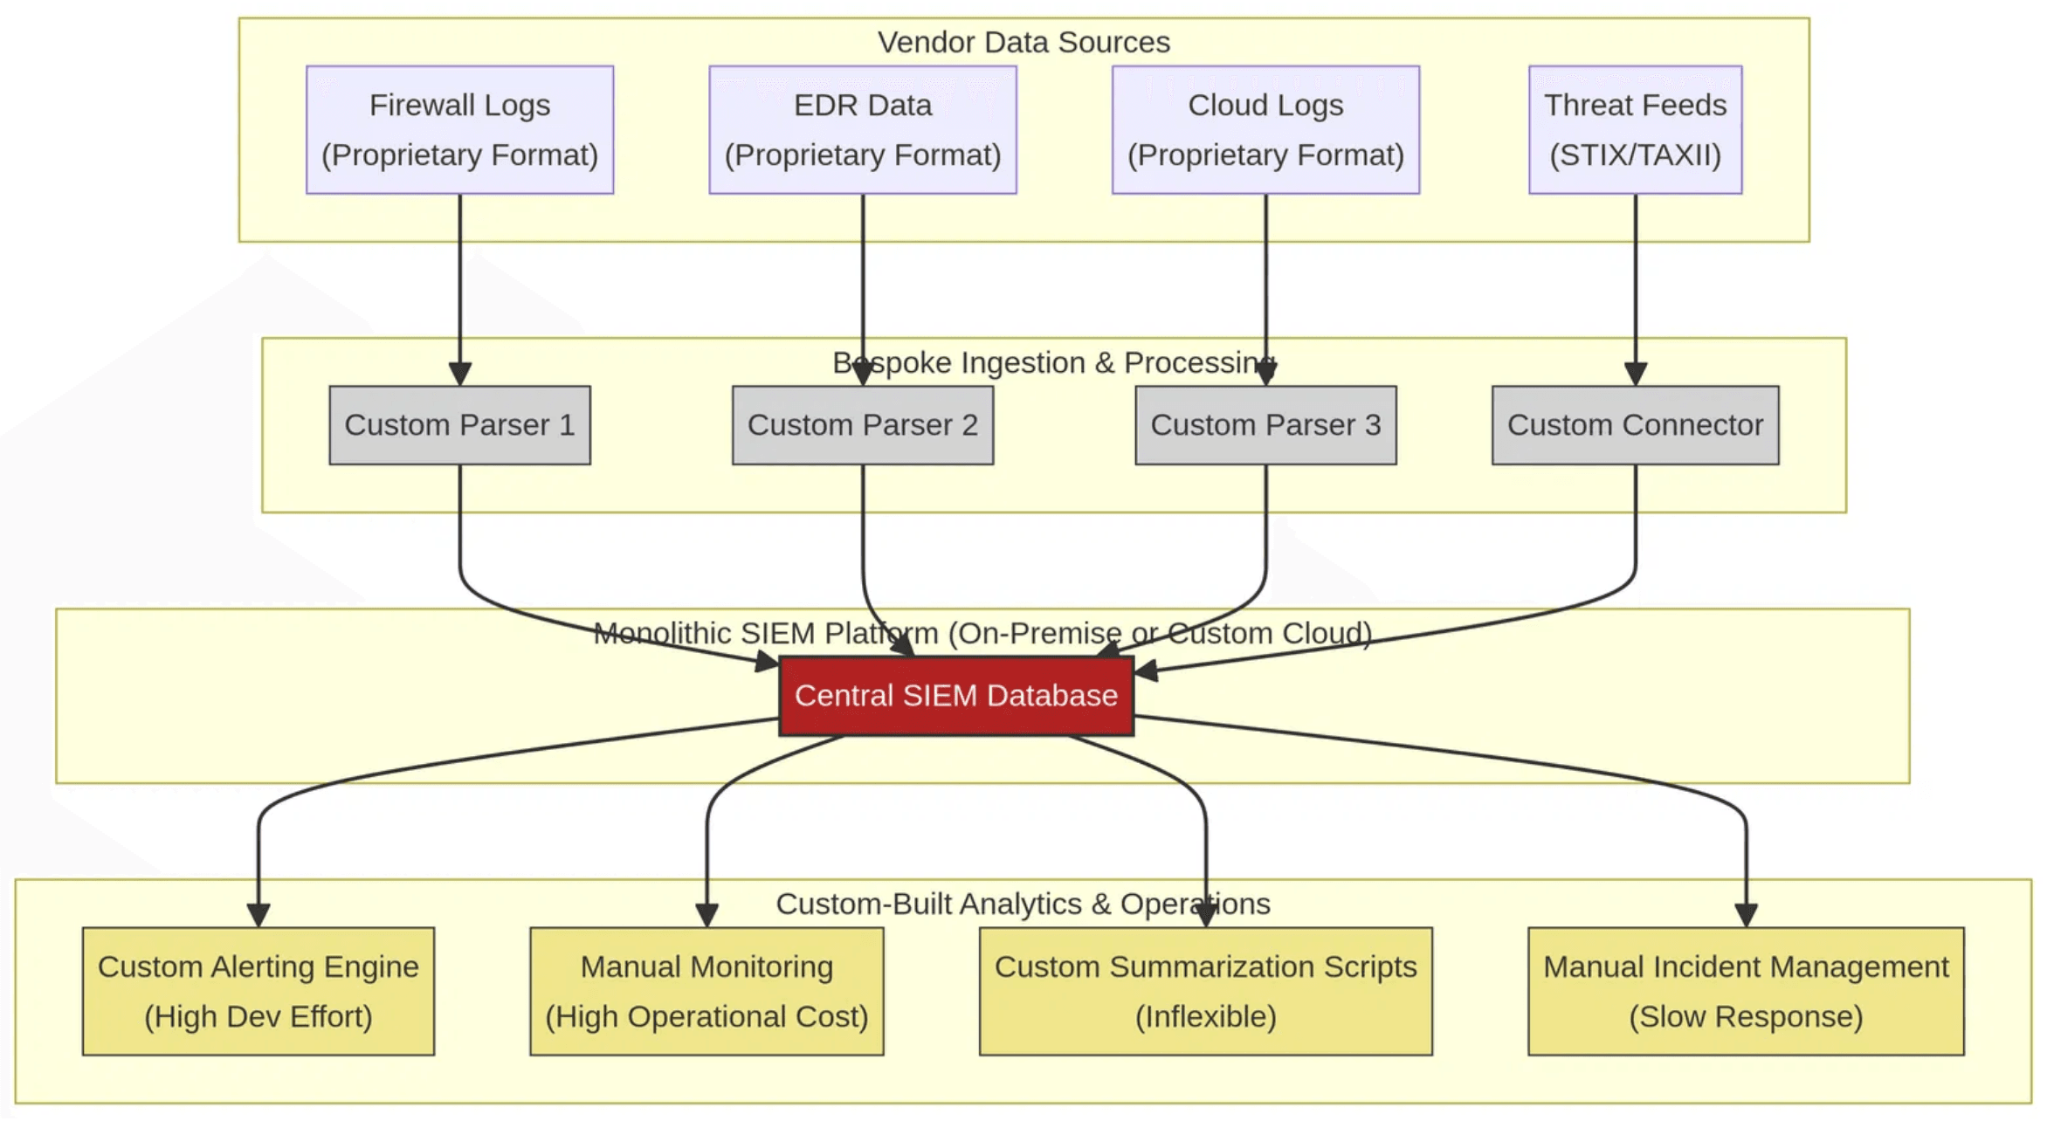
Traditional Architecture Complexity
The Integration Bottleneck: Every new tool requires a new custom parser. Data is siloed, correlation is manual, and maintenance consumes valuable engineering cycles.

Slide 4
The AWS Security Lake Solution
OCSF Standardization
Zero-Parser Ingestion
Managed Platform
Enterprise Scale
A Common Language
Automated Normalization
Built on Amazon S3 and AWS Organizations, it centralizes data from hundreds of accounts and regions into a single, scalable data lake with automated lifecycle management.
Automatically converts incoming data into the Open Cybersecurity Schema Framework (OCSF). This eliminates the "Tower of Babel" problem, enabling unified analytics across all security tools.
Eliminates the need to write and maintain custom parsers. Native AWS services and partner data are ingested and normalized automatically, freeing engineers from data plumbing.

Slide 5
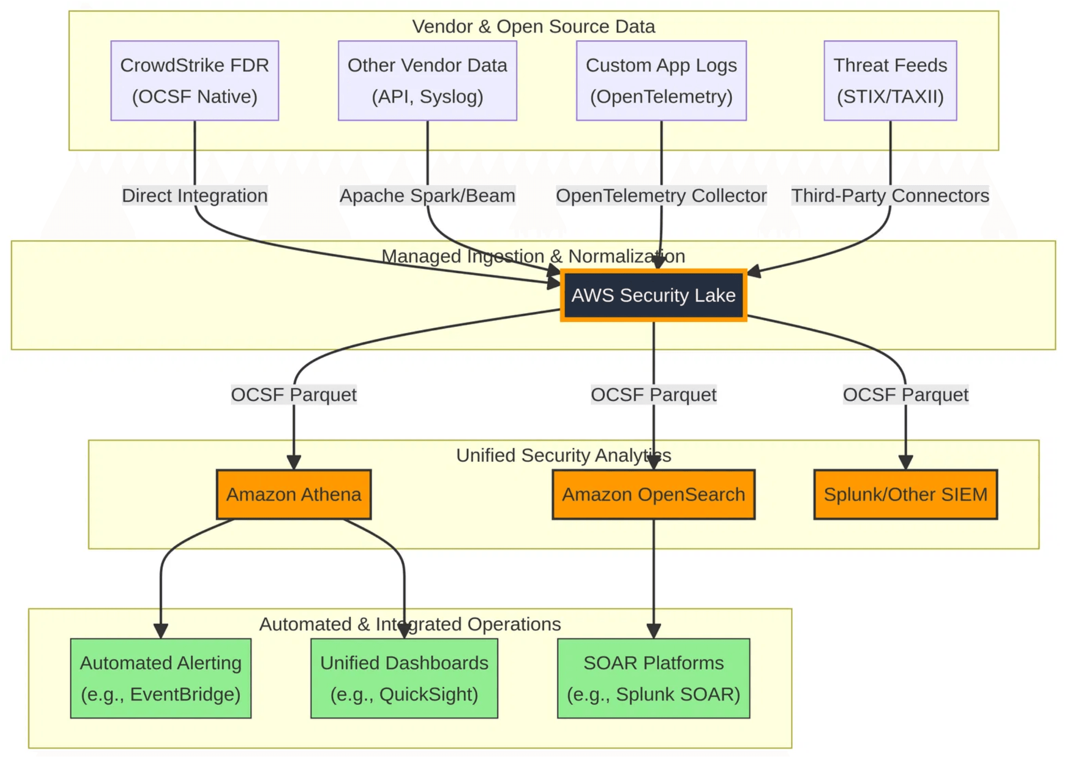
Modern Architecture with AWS Security Lake
Unified & Automated
Data is normalized to OCSF once and becomes instantly available to all downstream analytics and AI tools. No more silos, no more custom parsers.

Slide 6

Native AWS Data Sources Available Out-of-the-Box
AWS CloudTrail
Amazon VPC Flow Logs
Amazon S3 Server Access Logs
Complete API activity tracking across all AWS services, providing the backbone for auditing and compliance.
Detailed visibility into network traffic patterns and anomalies to detect potential network-based threats.
Granular object-level access tracking to monitor data access patterns and detect potential exfiltration.
AWS Security Hub Findings
AWS Config
Amazon CloudWatch Logs
Continuous monitoring and recording of AWS resource configuration changes for compliance and governance.
Aggregated security alerts and compliance status from over 50 AWS services and partner solutions.
Centralized collection of application and system logs for deep operational visibility and troubleshooting.

Slide 7
Seamless Third-Party Partner Integration
Endpoint Security
Network & Firewall
CrowdStrike
Palo Alto Networks
SentinelOne
Cisco Secure
Trend Micro
Zscaler
Identity & Access
Cloud & DLP
Okta
Symantec
CyberArk
Netskope
Ping Identity
Wiz

Slide 8
Core AWS Security Lake Capabilities
Centralized Management
Automated Normalization
Centralize data from multiple accounts and regions into a single, manageable data lake.
Convert raw logs into OCSF and apply lifecycle policies to optimize storage.
Cross-Account Aggregation
Auto-OCSF Conversion
Multi-Region Rollup
Lifecycle Management
Unified Querying
Native Alerting
Run SQL on OCSF data with Amazon Athena and allow secure, zero-copy access for tools.
Trigger alerts and automated responses from incoming data patterns for faster defense.
Amazon Athena Integration
Amazon EventBridge Triggers
Zero-Copy Subscriber Access
Real-time Response

Slide 9

End-to-End AI Security Solutions Available Today
AWS Native AI
Partner AI Solutions
Threat Intelligence AI
Amazon GuardDuty
AI/ML-powered threat detection with Extended Threat Detection (Dec 2024) that automatically links signals across EC2 and ECS to detect complex, multi-stage attacks.
CrowdStrike Charlotte AI
Recorded Future
Conversational AI for threat hunting and incident response within the CrowdStrike Falcon platform, integrated with Security Lake data.
AI-driven threat intelligence platform providing real-time enrichment of Security Lake data with threat context and adversary intelligence.
Amazon Detective
SentinelOne Purple AI
SecurityScorecard
GenAI-powered investigation that automatically summarizes finding groups, reducing investigation time from hours to minutes.
AI-powered security analyst that automates threat detection, response, and provides automated root cause analysis.
Attack Surface Intelligence providing contextualized external threat intelligence on-demand for Security Lake data.

Slide 10

Threat Intelligence Collection and Integration
Native AWS Threat Intelligence
GuardDuty findings (enriched with AWS threat intelligence) are automatically sent to Security Lake in OCSF format. Security Lake supports the OCSF Threat Intelligence event class for standardized IOCs and threat profiles.
Third-Party Threat Intelligence Integrations
Leading threat intelligence providers integrate seamlessly with Security Lake:
Recorded Future - Real-time enrichment
SecurityScorecard - Attack Surface Intelligence
CrowdStrike - Adversary Intelligence
Vectra AI - Attack Signal Intelligence
Automated Enrichment Workflow
1
2
3
4
Ingestion
Normalization to OCSF
Auto-Enrichment
Automated Response
Threat intelligence feeds are ingested, normalized to OCSF, and automatically enrich Security Lake data. Enriched data triggers automated responses via EventBridge and SOAR platforms.

Slide 11

Partner Ecosystem Accelerates Advanced Capabilities
Advanced SIEM Platforms
Automated SOAR Orchestration
High-Fidelity Threat Intelligence
Key Partners
Key Partners
Key Partners
Splunk Sumo Logic Rapid7
Swimlane Torq Palo Alto XSOAR
Recorded Future CrowdStrike Mandiant
Connect as subscribers to offer advanced correlation engines, pre-built security content, and mature case management features backed by decades of expertise.
Ingest OCSF data to orchestrate sophisticated, cross-platform response playbooks, dramatically reducing manual effort and mean time to respond (MTTR).
Provide deep contextual enrichment, enabling proactive threat hunting based on the latest adversary tactics, techniques, and procedures (TTPs).

Slide 12

The Strategic Advantage of "Buy vs. Build"
Deploy in Days
Zero Dev Time
Day-One Value
Instant-On Functionality
Eliminate Bottlenecks
Immediate Capabilities
The AWS Security Lake Ready program validates solutions for out-of-the-box compatibility. Deploy enterprise-grade tools in hours, bypassing months of custom integration work.
Stop writing and maintaining custom parsers. With standardized OCSF data, engineering resources can shift immediately from "data plumbing" to high-value threat hunting.
Don't build from scratch. Subscribe to partners like Recorded Future to enrich data instantly. Build a comprehensive security stack at a pace impossible with a DIY approach.

Slide 13

From Data Plumbing to Proactive Defense
Operational Efficiency
Accelerated Innovation
Proactive Security Posture
Eliminate parser maintenance, reduce infrastructure costs, and free engineering resources for strategic security initiatives rather than data plumbing.
Deploy new detections, integrate new tools, and respond to emerging threats in hours instead of weeks by leveraging the ecosystem.
Move beyond reactive incident response to predictive, automated, and intelligent security operations powered by AI and standardized data.
Organizations embracing this standardized approach gain not just a platform, but a strategic advantage in the ongoing battle against sophisticated cyber threats.

Slide 14
References
[01]
How to Build a SIEM System: Architecture & Tools
[05]
Unlocking the Power of the SOC through OCSF
PuppyGraph
Standardization
[02]
SIEM as a Service Price in 2025: Costs and Key Factors
Hunters
ClearNetwork
[06]
Use an Amazon Bedrock powered chatbot with
[03]
Third-party integrations with Security Lake
Amazon Security Lake
AWS Documentation
AWS Security Blog
[04]
[07]
GenAI for your biggest security operations challenges
Siemens Boosts Security Visibility Across 800+ AWS
Accounts
Trellix
AWS Case Study
[08]
Streamline Your Security Data Management with
Amazon Security Lake Ready Partner Solutions
AWS Partner Network Blog

Slide 15

Appendix: OCSF - What and Why
What is OCSF?
Why OCSF?
The Open Cybersecurity Schema Framework is an open-source, vendor-agnostic schema for cybersecurity data, developed by AWS and industry leaders (Splunk, IBM, Palo Alto Networks, etc.).
Eliminates Vendor Lock-In
Traditional security environments have dozens of proprietary data formats. OCSF provides a single, unified schema that all tools can speak, eliminating the "Tower of Babel" problem.
Key Components
Event Classes:
40+ standardized event types (Authentication, Network Activity, Detection Finding)
Enables Ecosystem Innovation
Objects:
Reusable data structures (User, Device, Process)
Vendors can build tools that work with any OCSF-compliant data source. Reduces integration time from months to days.
Attributes:
Standardized fields (src_ip, dst_ip, severity)
Future-Proof
As new tools emerge, they integrate with existing data without custom work. Open-source governance ensures the schema evolves with the industry.

Slide 16
Appendix: OCSF - Key Considerations
Schema Mapping
Versioning & Evolution
Governance & Compliance
Challenge
Living Standard
Not all vendor data maps perfectly to OCSF. Some vendors provide richer data; others provide less structured data.
OCSF is actively maintained by the community. New event classes and attributes are added regularly.
Data Ownership
OCSF normalizes data but does not change ownership or access controls. Align Security Lake policies with compliance requirements.
Key Considerations
Solution
Maintain backward compatibility
OCSF Extensions preserve unique vendor data
Use schema registry to track versions
Audit Trail
Maintain an audit trail of all transformations applied to raw data. Critical for forensic investigations and compliance audits.
Custom mappings for non-standard data
Test transformations against new releases
Apache Beam/Spark for complex transformations

Slide 17

Appendix: AWS Security Lake - Architecture Deep Dive
Core Architecture Components
Event-Driven Automation
Amazon S3 Foundation:
Security Lake emits EventBridge events on new data, enabling real-time alerts and automated workflows with Lambda, Step Functions, and SOAR integrations.
Uses S3 with Parquet, partitioned by date/source.
AWS Organizations:
Centralized, delegated admin model for multi-account setups.
OCSF Engine:
Managed normalization converting native logs to OCSF; supports custom sources.
Data Access Patterns
Subscriber Model:
Zero-copy access from S3 for AWS services and third-party tools.
Query Federation:
Athena enables SQL across lake data with exportable results.

Slide 18

Appendix: AWS Security Lake - Operational Details
Pricing Model
Regional Availability
Lifecycle Management
Compliance & Certifications
Pay-As-You-Go: Charged per GB ingested, standard S3 storage, and Athena query costs.
US East (N. Virginia, Ohio)
Automated Data Retention: Define retention policies at the source level; Security Lake applies S3 lifecycle policies automatically.
SOC 1, 2, and 3
US West (Oregon, N. California)
ISO 27001, 27017, 27018
Cost Optimization: Use S3 Intelligent-Tiering, partition by date/source, enable query result caching.
PCI DSS Level 1
Europe (Ireland, Frankfurt, London)
HIPAA eligible
FedRAMP Moderate (select regions)
Asia Pacific (Tokyo, Singapore, Sydney)
Data Replication: Enable S3 Cross-Region Replication for disaster recovery and business continuity.
Multi-Region Rollup: Aggregate data from multiple regions into a single "home" region.

